Slide 1
Energy Transfers
Notes:
Start

Slide 2
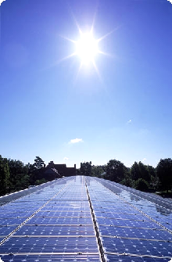
Energy
Energy is required to do work:
Fuels are burnt to release energy
The Sun is the ultimate source of most of our energy on Earth.
Notes:
2
The Earth

Slide 3
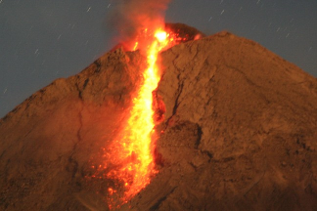

Forms of energy
Energy can exist in many forms.
1. THERMAL or HEAT ENERGY
This is the energy of an object due to its temperature.
2. Light energy
This is energy in the form of visible electromagnetic radiation.
Notes:
3
Light

Slide 4
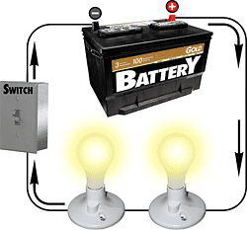

3. Electrical energy
This is the energy transferred by an electric current.
4. Sound energy
This is energy in the form of a sound wave.
Notes:
4
Sound

Slide 5

5. KINETIC ENERGY
This is the energy possessed by a moving object. Kinetic energy increases is the object’s speed is increased. Also often called ‘Movement energy’.
Notes:
5
Moving

Slide 6

6. CHEMICAL ENERGY
This is energy that is released when chemical reactions take place. Sources of chemical energy include: fuel, food and batteries.
Notes:
6
Types

Slide 7
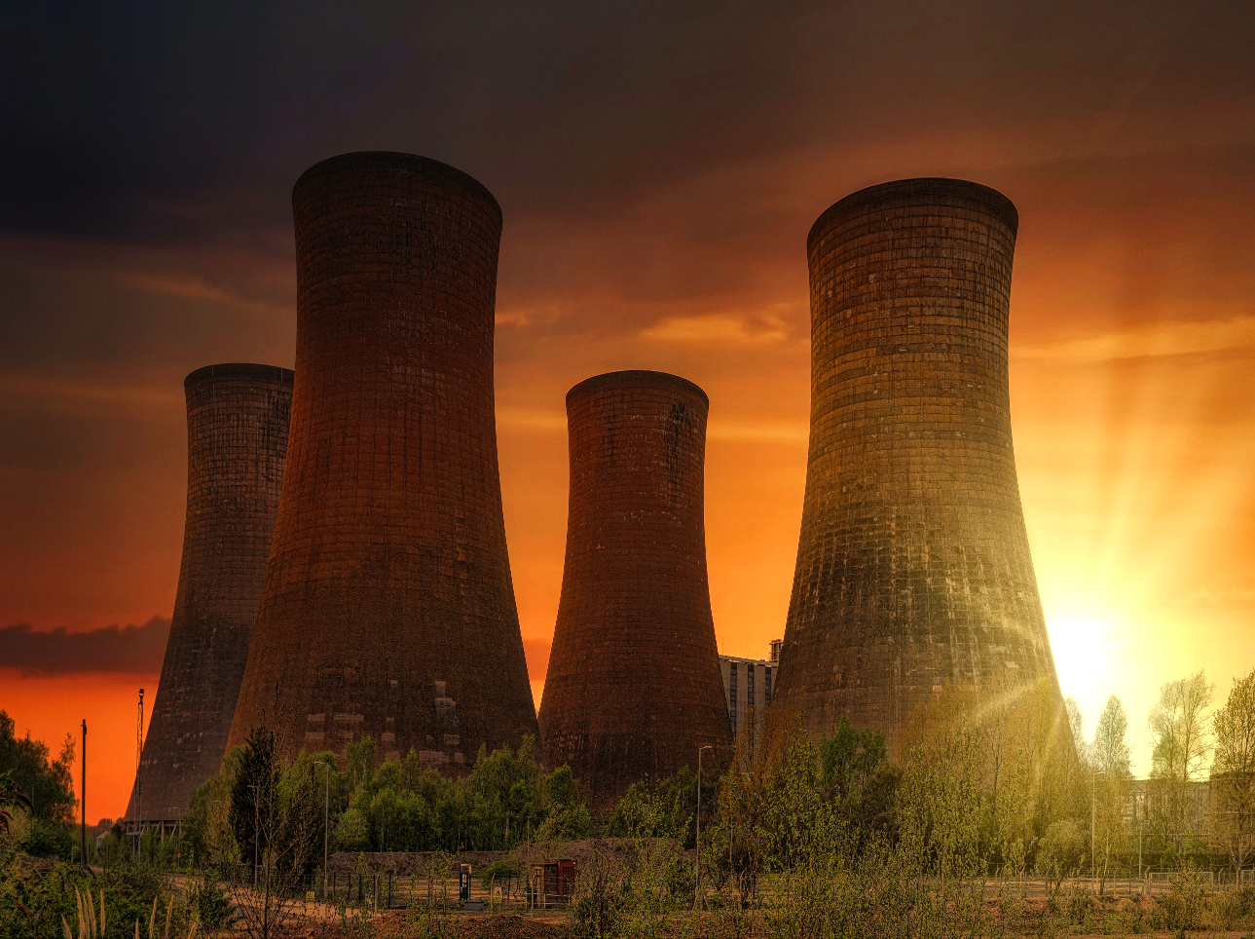
7. NUCLEAR ENERGY
This is energy that is released when nuclear reactions take place. This is the source of the Sun’s energy.
Notes:
7
Types

Slide 8
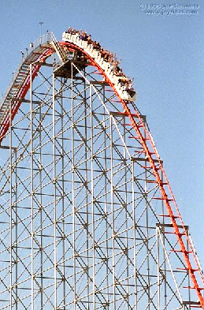
8. POTENTIAL ENERGY
This is the energy possessed an object due to its position.
Gravitational Potential Energy
The gravitational potential energy of an object increases if it is raised upwards.
Elastic Potential Energy
This is the energy stored in a stretched or squashed object
- also known as strain energy
Notes:
8
Test

Slide 9
Energy resources
Renewable energy resources | Nonrenewable energy resources
Solar radiation | Oil
Hydraulic | Natural gas
Wind | Coal
Wave | Fossil fuel alternatives (oil sands, peat, wood)
Biomass | Biomass (if inadequately regenerated)
Geothermal | Wastes
Tidal | Uranium
Notes:
Good Job

Slide 10
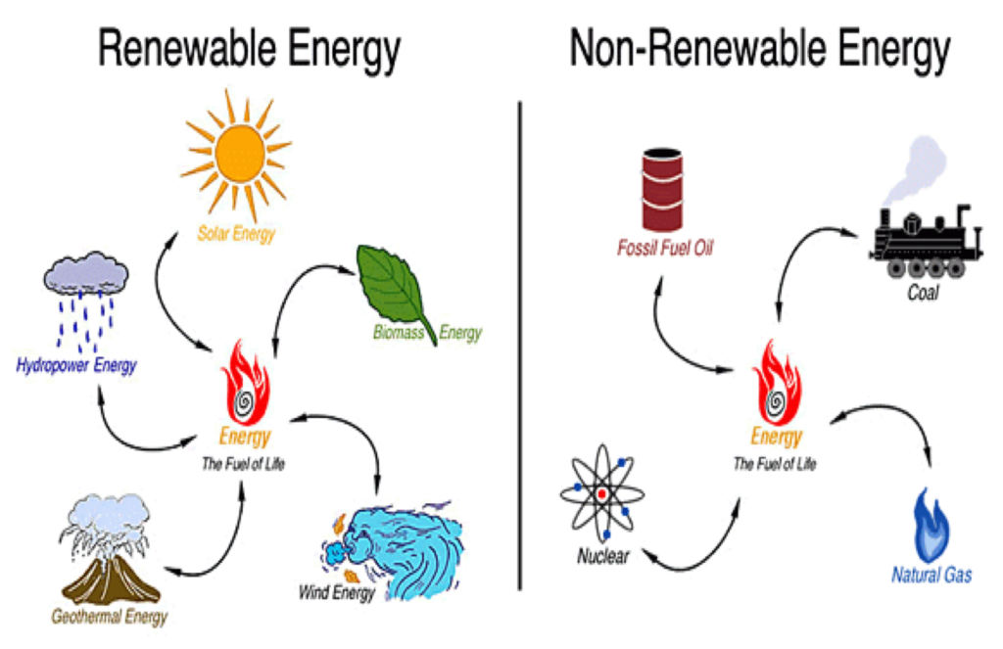
Energy resources
Notes:
Protect

Slide 11
Energy Consumption

Slide 12
Energy Management Cycle
Understanding Energy Use
Planning and organizing
Implementation
Monitoring
Commitment

Slide 13
Good luck ☺
Thank You!
Notes:
The end

