Slide 1

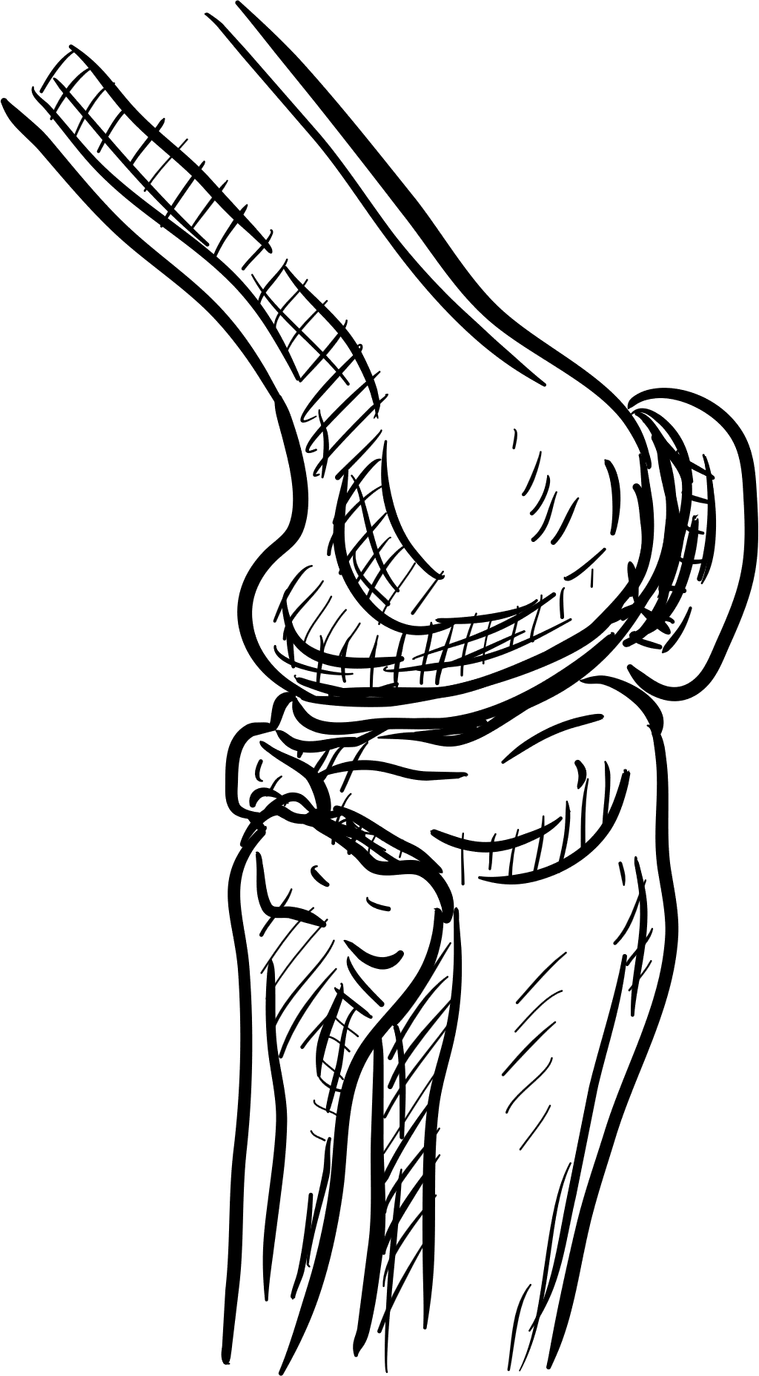

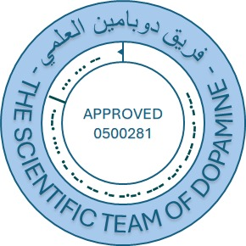
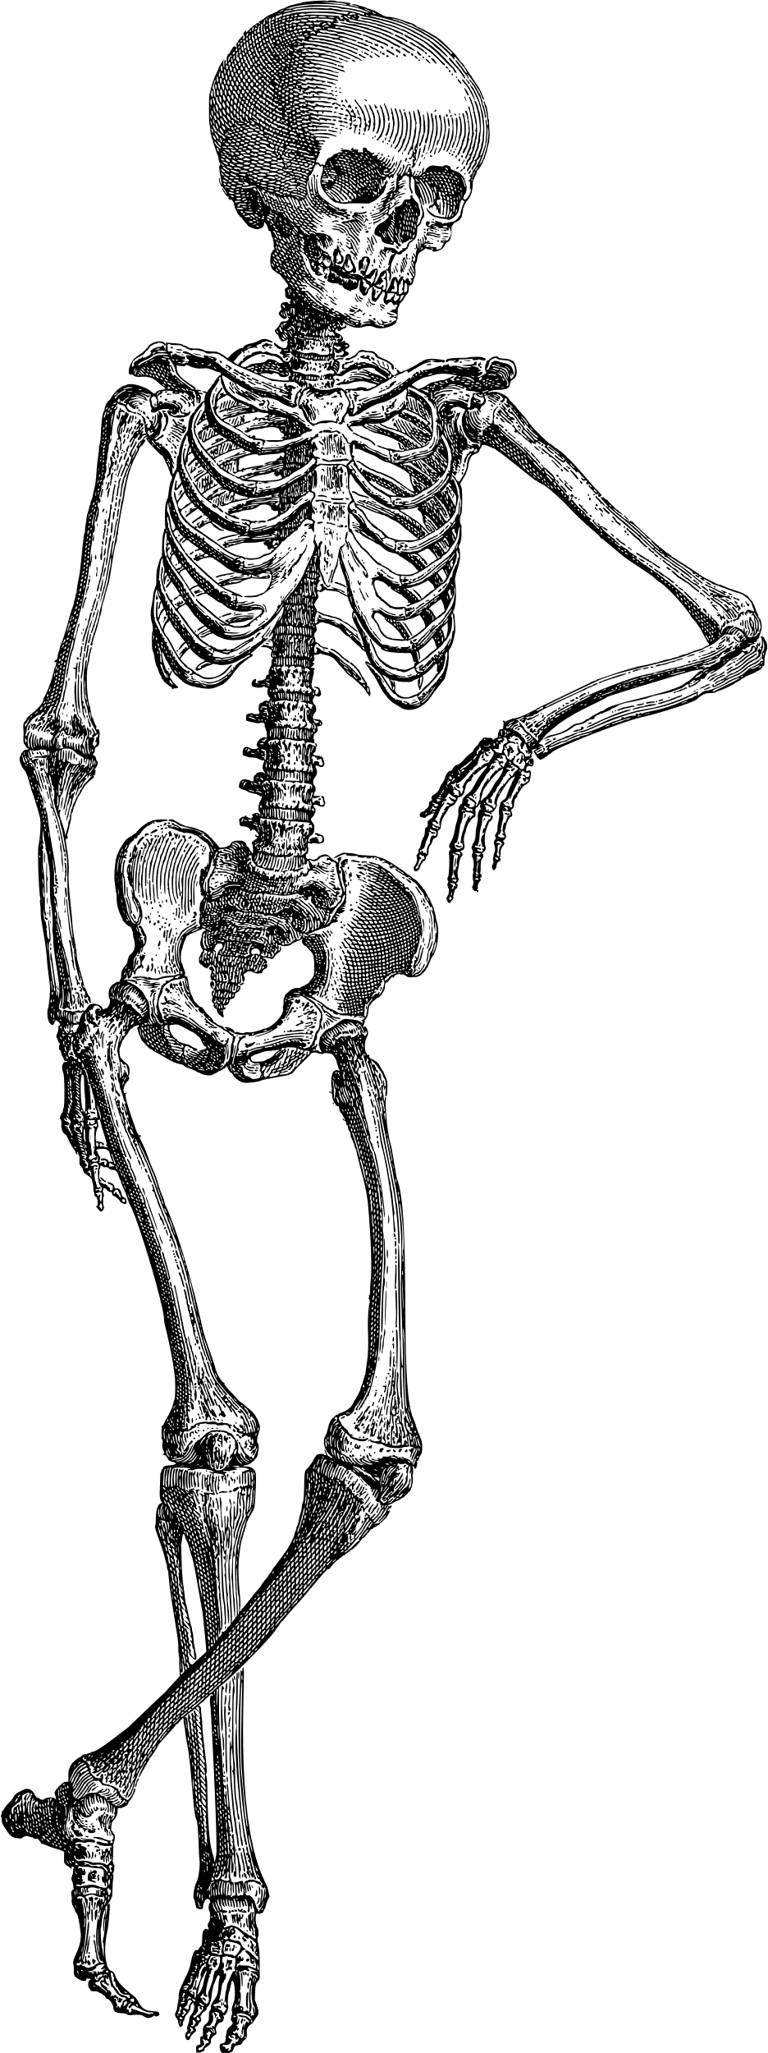

بسم الله الرحمن الرحيم
Test Bank
Final | Lab
Skin Histology Lab
اللهم استعملنا ولا تستبدلنا
HISTOLOGY
Written by:
Waleed Darawad
Reviewed by:

Slide 2
This is a test bank, not a past papers file.
Yet, it’s great if you're able to solve it with no mistakes, it’s easy actually

Slide 3
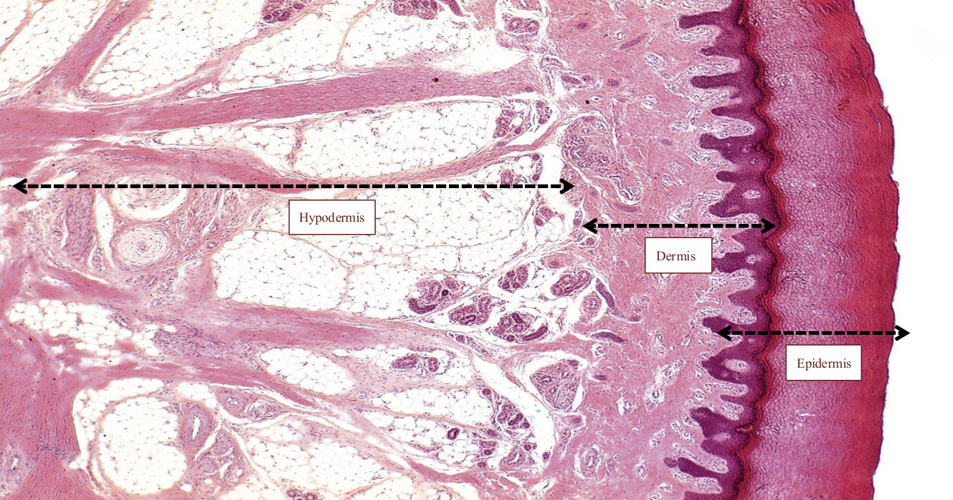
Q1: No.1 indicates which part of the skin?
Dermis
Hypodermis
Epidermis
Sebaceous gland
Pacinian Corpuscle
3
2
1
Answer: C

Slide 4
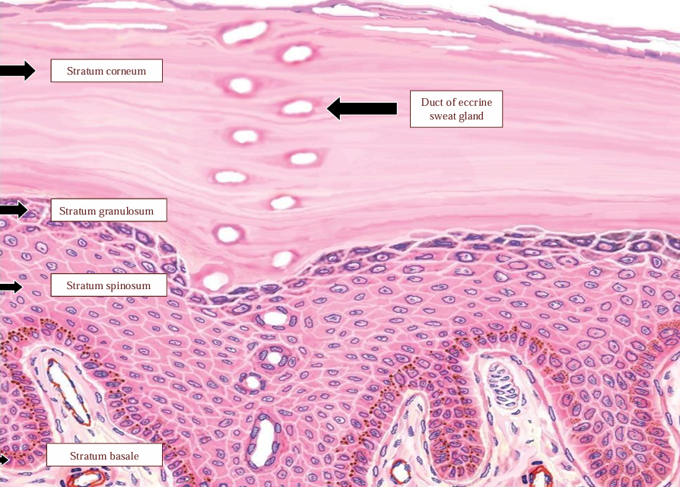
Q2: Which of the following is “stratum granulosum”?
1
2
3
4
5
1
2
3
4
5
Answer: C

Slide 5
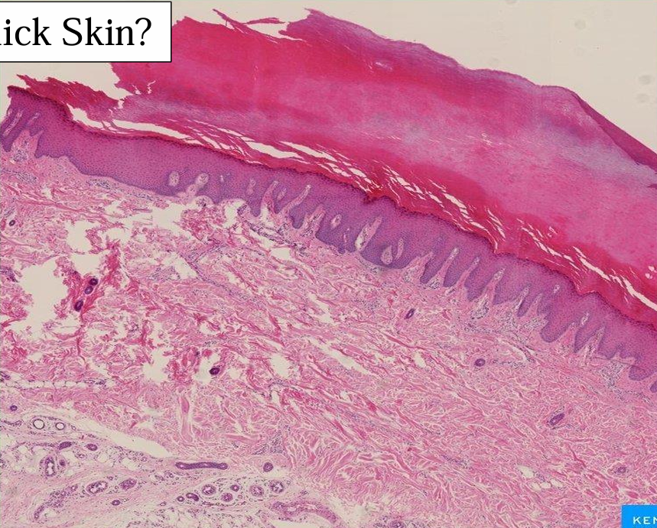
Q3: Is this thick or thin skin? Why?
Thick, because the hypodermis layer is thick
Thin, because the dermis layer is thin
Thick, because there are no hair follicles, neither sebaceous glands
Thin, because the ridges are prominent
None of the following
Answer: C

Slide 6
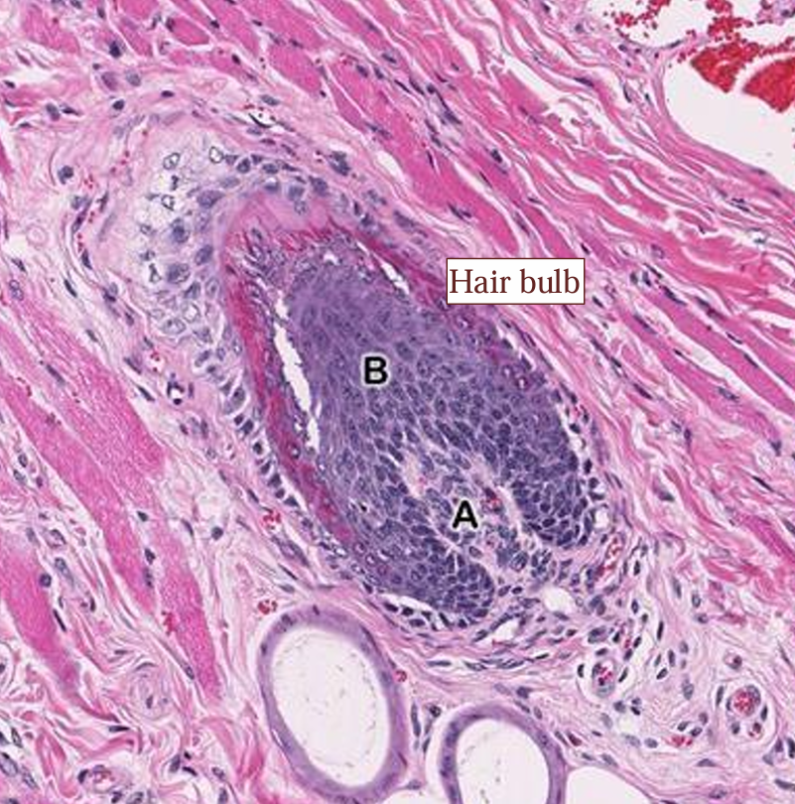
Q4: What do “A” & “B” represent, respectively?
Dermal papilla, hair matrix
Hair matrix, dermal papilla
Inner root sheath, outer root sheath
Outer root sheath, inner root sheath
Hair root, hair bulb
Answer: A

Slide 7
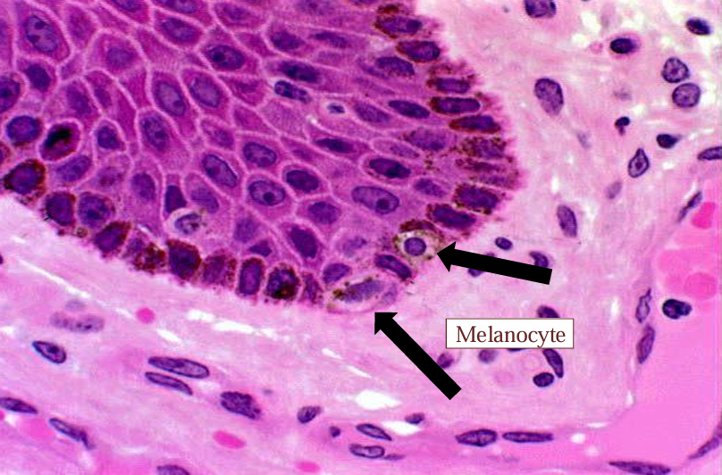
Q5: The pointed cells are?
Keratinocytes
Melanocytes
Langerhans
Merkel’s
Adipocytes
Answer: B

Slide 8
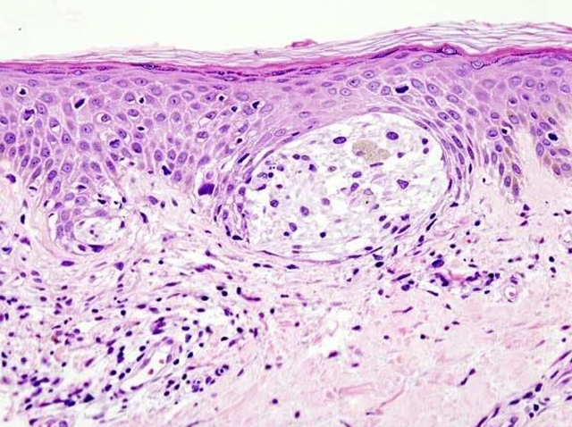
Q6: This condition suggests the early stages in the development of?
Albinism
Psoriasis
Calluses
Corns
Melanoma
Answer: E
Note how there are melanocytes in the upper layers of epidermis

Slide 9
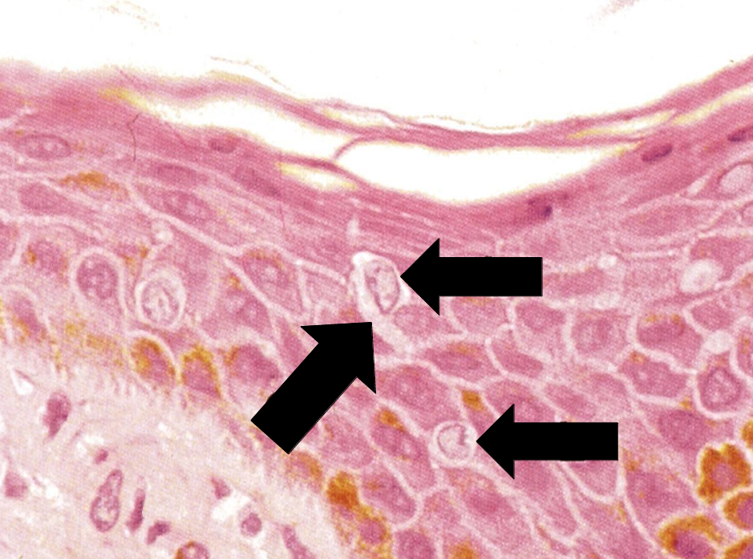
Q7: These cells are?
Keratinocytes
Melanocytes
Langerhans
Merkel’s
Adipocytes
Answer: C

Slide 10
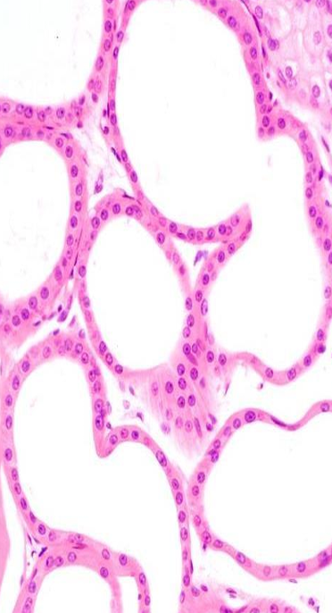
Q8: What gland is this?
Eccrine sweat gland
Apocrine sweat gland
Sebaceous gland
Pituitary gland
None of the following
Answer: B

Slide 11
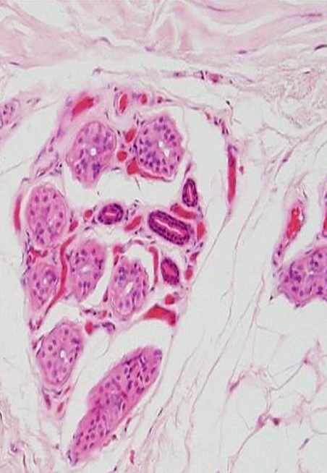
Q9: What gland is this?
Eccrine sweat gland
Apocrine sweat gland
Sebaceous gland
Pituitary gland
None of the following
Answer: A

Slide 12
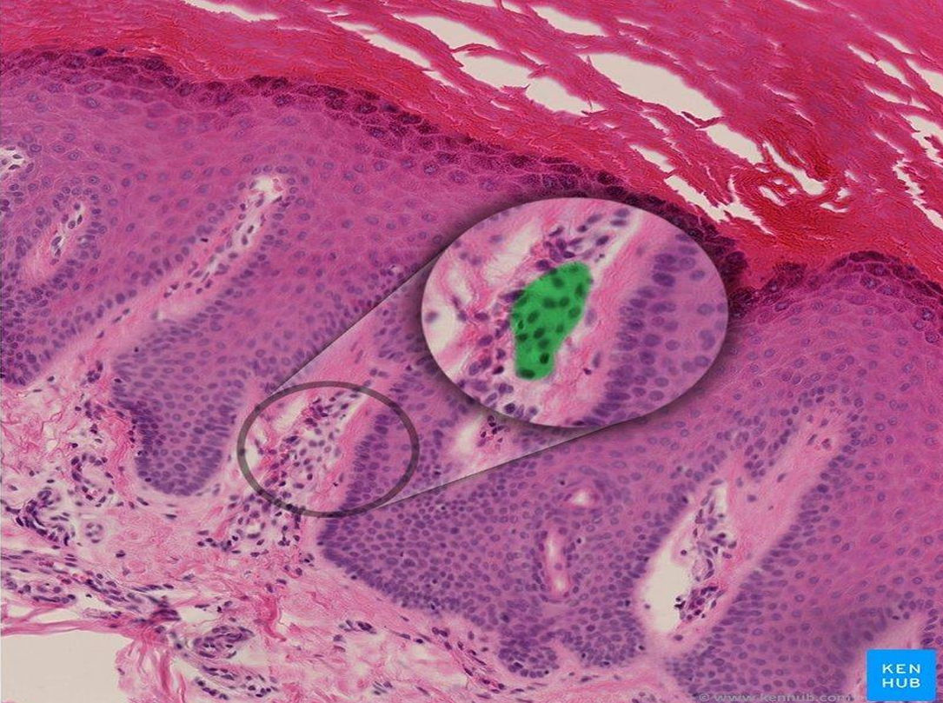
Q10: What is this?
Meissner's corpuscle
Pacinian corpuscle
Arrector pili
Langerhans cells
None of the following
Answer: A

Slide 13
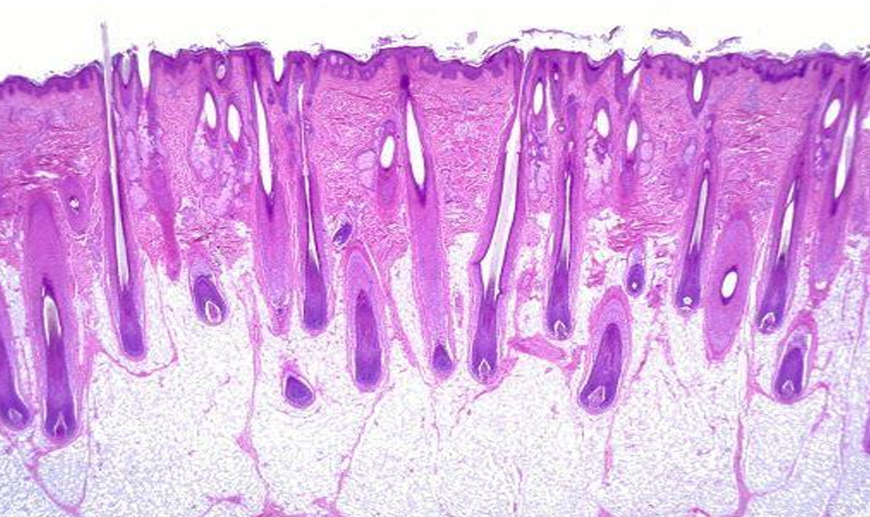
Q11: Is this thin or thick skin? Why?
Thick, because of hair follicles presence
Thin, because of hair follicles presence
Thick because the dermis is thick
Thin, because the dermis is thick
A & C
B & D
Answer: F

Slide 14
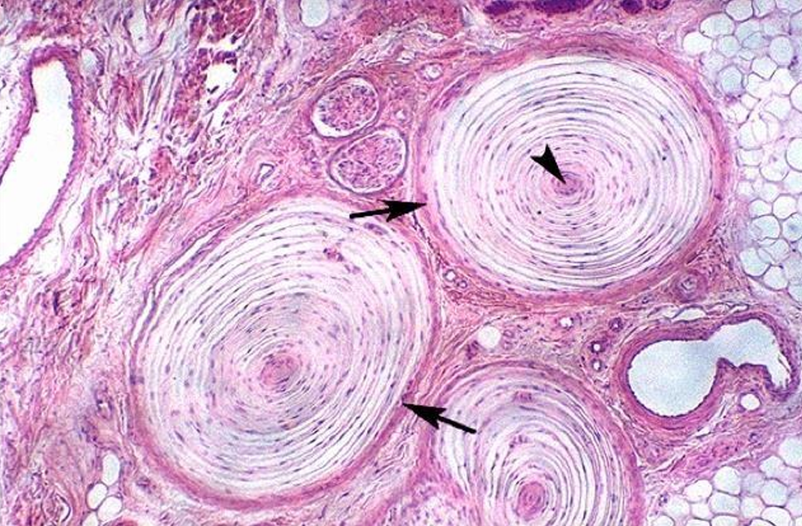
Q12: What is this?
Meissner's corpuscle
Pacinian corpuscle
Arrector pili
Langerhans cells
None of the following
Answer: B

Slide 15
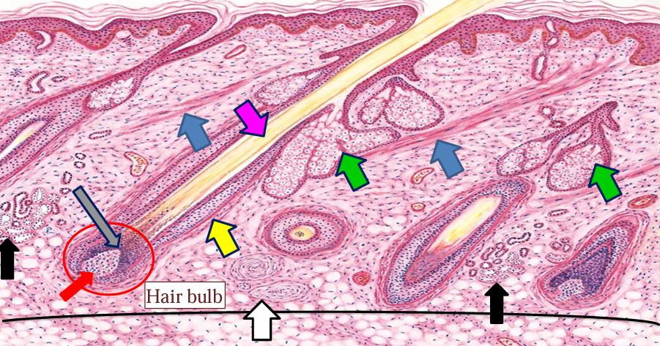
Q13: What does the blue arrow point at?
Meissner's corpuscle
Pacinian corpuscle
Arrector pili
Langerhans cells
None of the following
Answer: C

Slide 16
Q14: What does the purple arrow point at?
Meissner's corpuscle
Pacinian corpuscle
Arrector pili
Langerhans cells
None of the following
Answer: E
It’s a hair shaft

Slide 17
Q15: What does the yellow arrow point at?
Meissner's corpuscle
Pacinian corpuscle
Arrector pili
Langerhans cells
None of the following
Answer: E
It’s a hair follicle

Slide 18
Q16: What do the black arrows point at?
Sebaceous glands
Arrector pili
Hair shaft
Pacinian corpuscle
None of the following
Answer: E
They’re sweat glands

Slide 19
Q17: What do the green arrows point at?
Sebaceous glands
Arrector pili
Hair shaft
Pacinian corpuscle
None of the following
Answer: A

Slide 20
الحمد لله

Slide 21
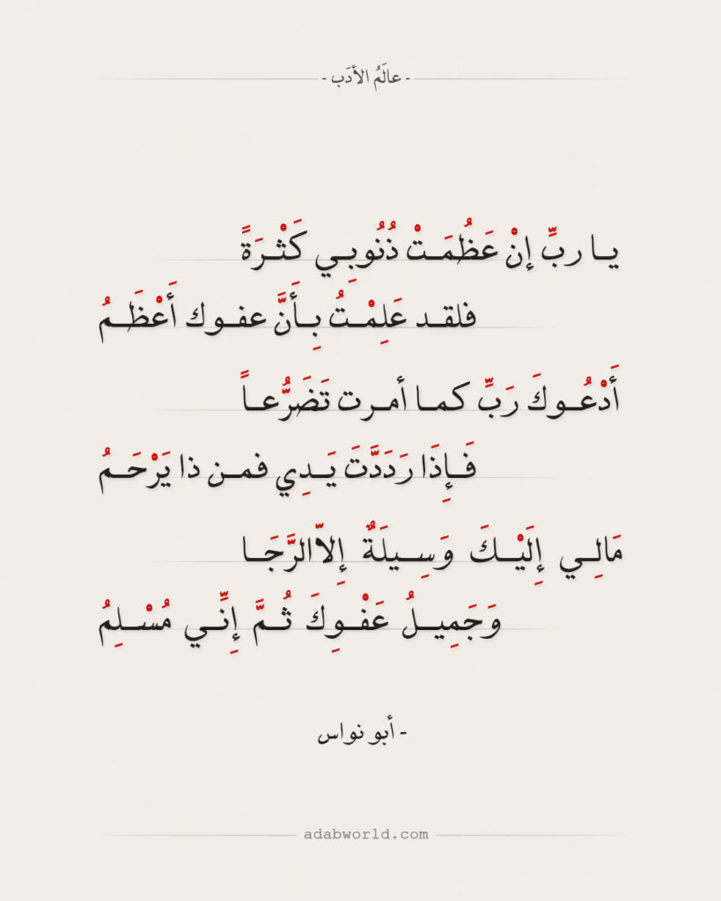
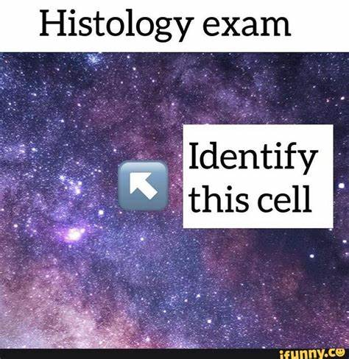
Additional Resources:
رسالة من الفريق العلمي:

Slide 22

For any feedback, scan the code or click on it.
QR code
for access of feedback form
Corrections from previous versions:
Versions | Slide # and Place of Error | Before Correction | After Correction
V0 → V1 | Slide 13 | Answer was E | Answer is F
V1 → V2

